Slide 1
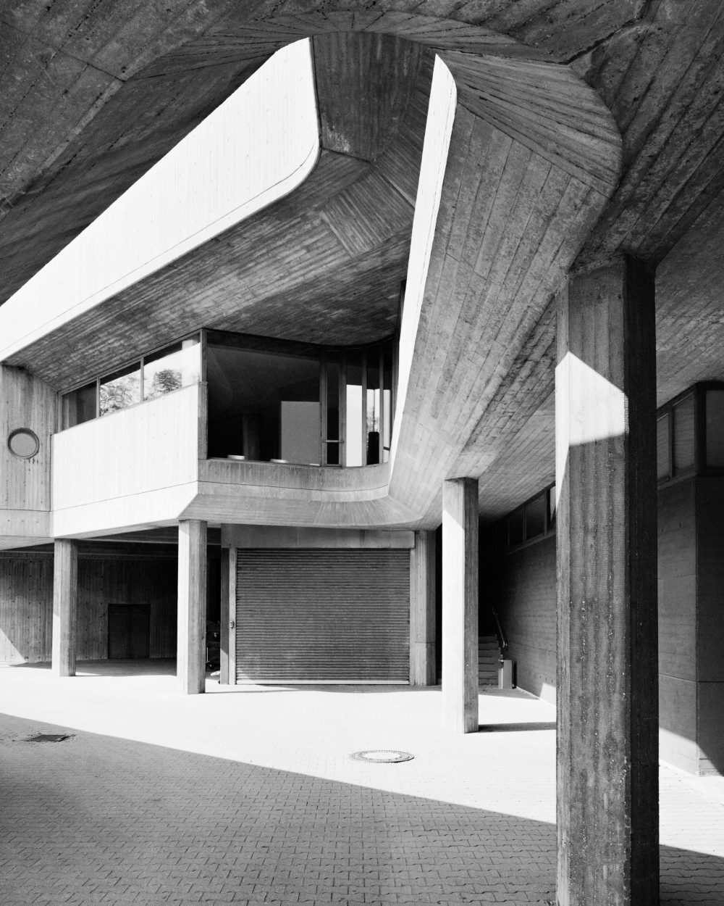
Chronic Urticaria
and atopic dermatitis
with focus on children
Martin Metz
Institute of Allergology
Charité - Universitätsmedizin Berlin
https://bullahuth.de/portfolio/institut-fuer-hygiene-und-mikrobiologie/

Slide 2
Disclosure of Significant Relationships with
Commercial Companies and Organizations
Martin Metz is or was a speaker and/or advisor for
AbbVie, Amgen, ArgenX, AstraZeneca, Bayer, Celldex, Celgene, Escient, Galderma, Grünenthal, GSK, Menlo, Novartis, Pfizer, Pharvaris, Roche, Sanofi-Aventis, Third Harmonic Bio.
2022 for past five years

Slide 3
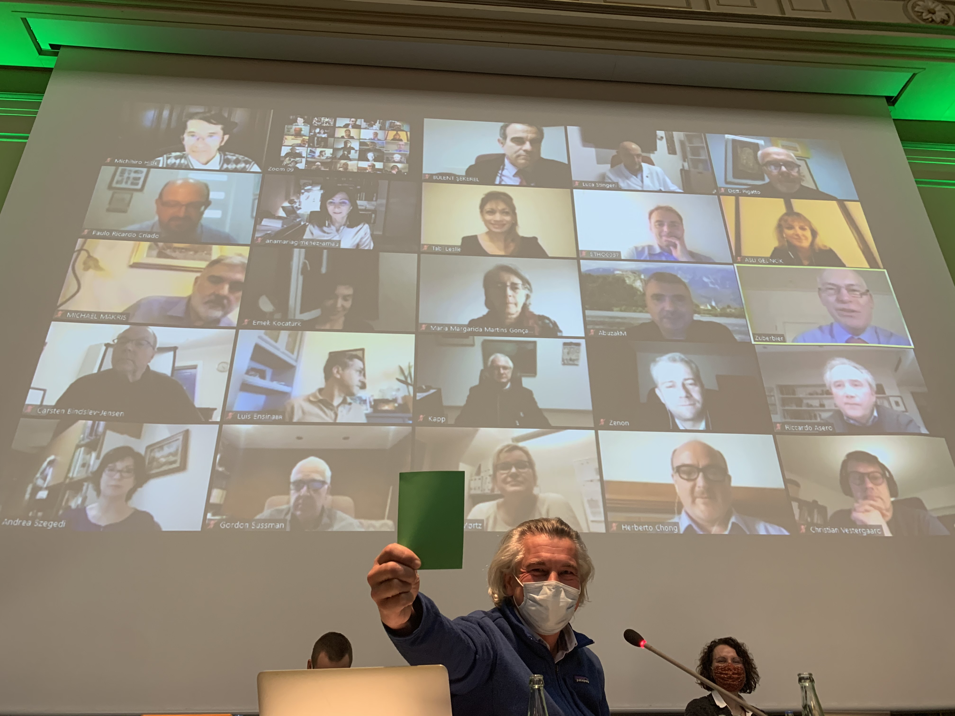
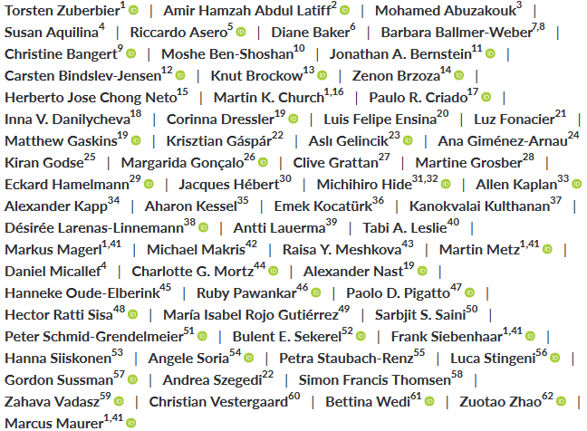
EAACI/GA²LEN/EuroGuiDerm/APAAACI Guideline for Urticaria: 2020 revision and update
Zuberbier et al., Allergy. 2022;77:734-766

Slide 4
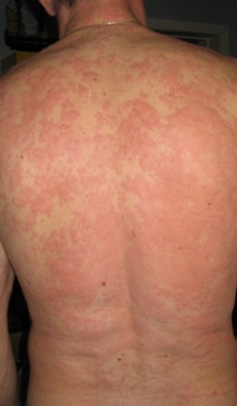
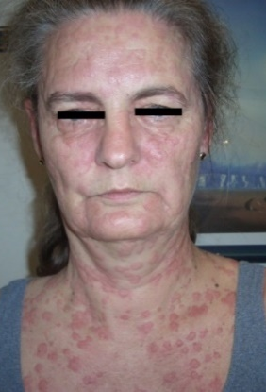
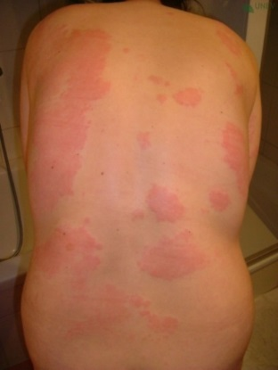
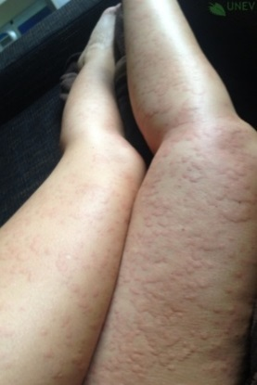
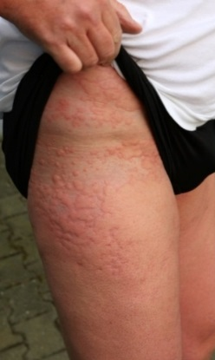
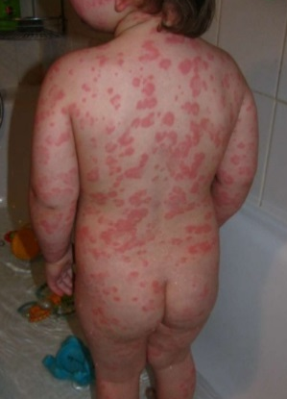
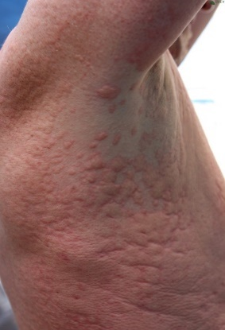
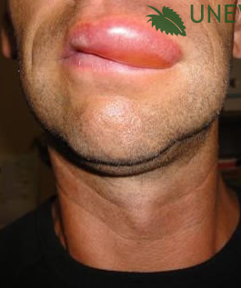
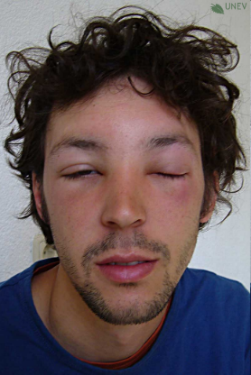
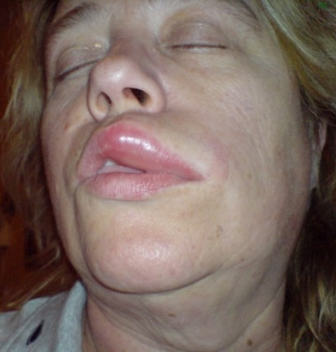
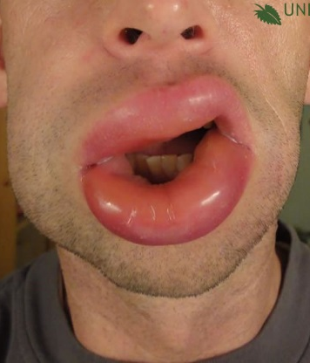
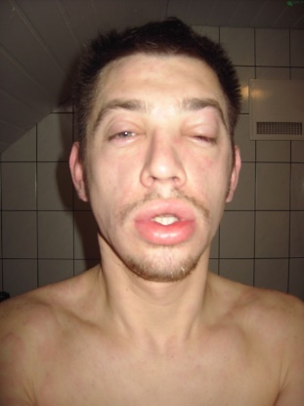
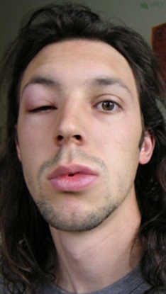
What is chronic urticaria ?
Itchy wheals
Angioedema
…or both, for longer than 6 weeks

Slide 5
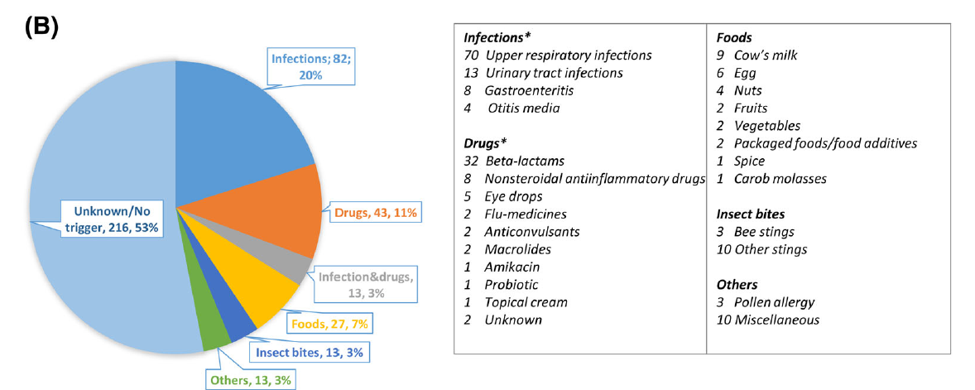
What do we know about acute urticaria (in children)?
Suspected trigger in children
Bezirganoglu et al., Pediatr Dermatol. 2022; in press

Slide 6
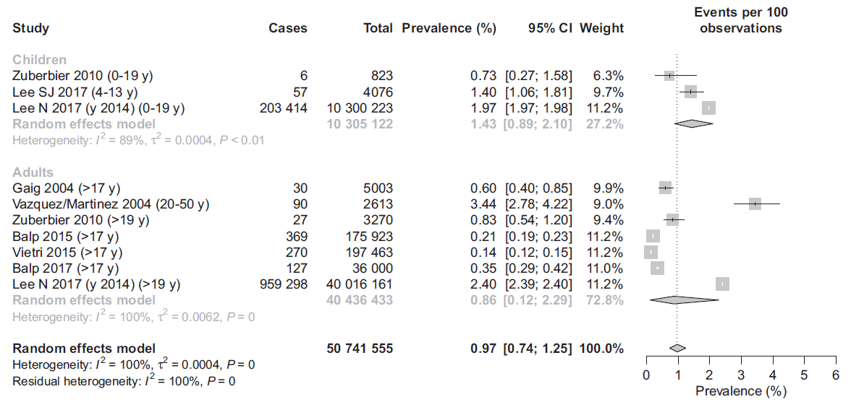
Chronic urticaria in children is at least as common as in adults
Fricke et al., Allergy. 2020;75:423-32

Slide 7
Classification of chronic urticaria
Chronic spontaneous urticaria
Chronic inducible urticaria
(CSU)
Due to known or unknown cause
(CINDU)
Symptomatic dermographism
Cold Urticaria
Delayed pressure urticaria
Solar urticaria
Heat urticaria
Vibratory angioedema
Cholinergic urticaria
Contact urticaria
Aquagenic urticaria

Slide 8
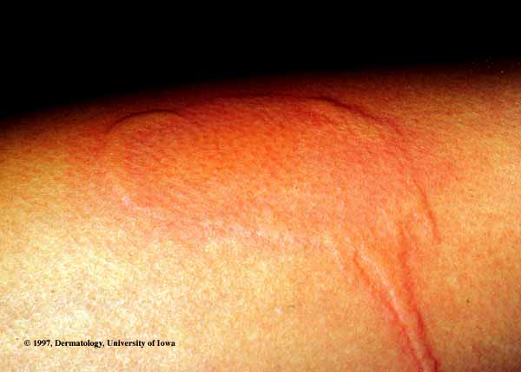
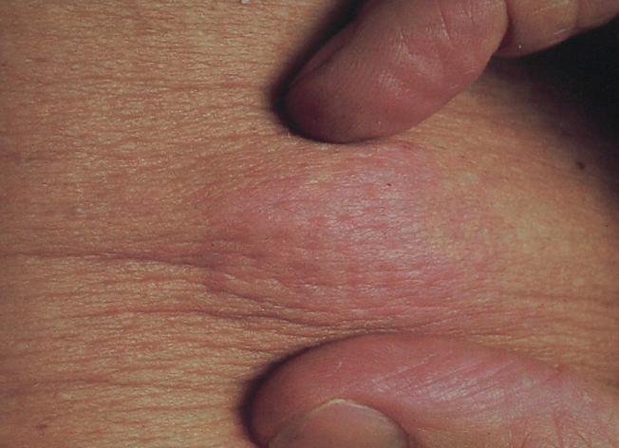
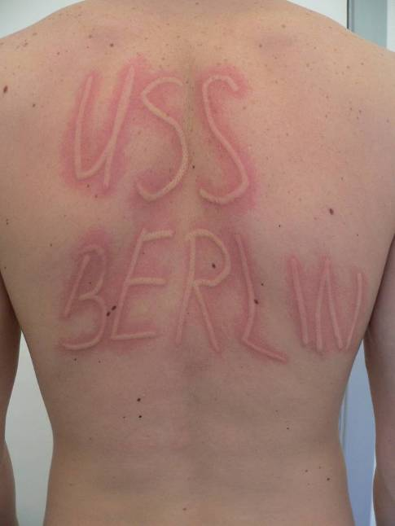
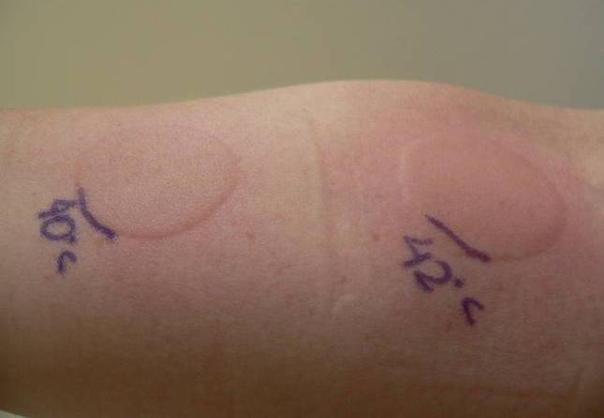
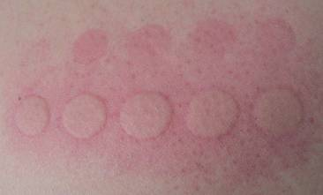
Inducible urticaria
Pressure
Cold
Cholinergic
Heat
UV Light
Friction

Slide 9
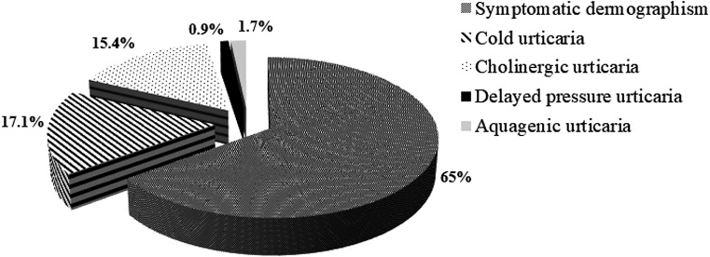
Inducible urticaria in children
Bal et al., Pediatr Allergy Immunol. 2021;32:146-52

Slide 10
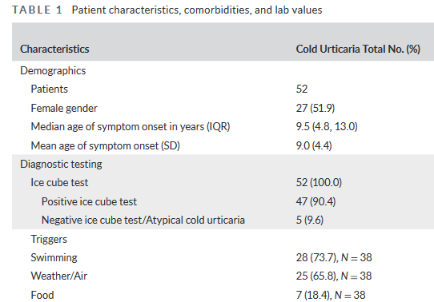

Cold urticaria in children
Cold
Prosty et al., Pediatr Allergy Immunol. 2022;33(3):e13751

Slide 11
Diagnostics in chronic spontaneous urticaria (CSU)
“The diagnostic workup of CSU in children has the same aims as in adults.”
Zuberbier et al., Allergy. 2022;77:734-766

Slide 12
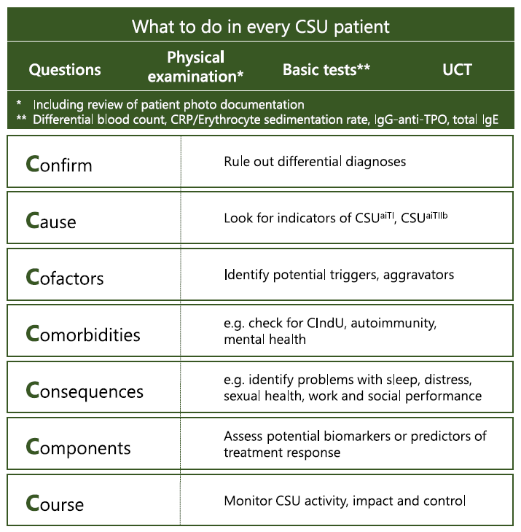
The 7Cs in diagnosis
Metz et al., J Allergy Clin Immunol Pract. 2021;9:2274-2283
Zuberbier et al., Allergy. 2022;77:734-766

Slide 13

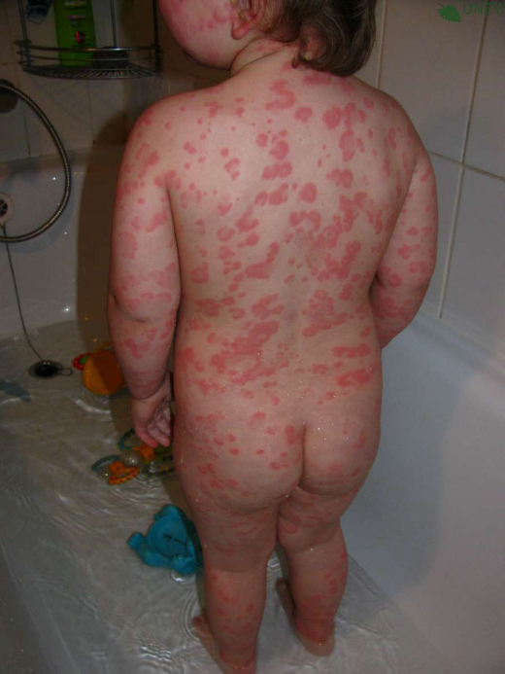

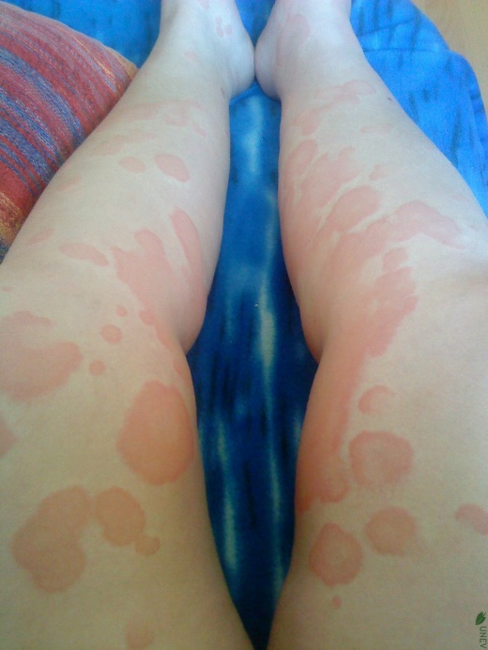
What is it, if it‘s not urticaria ?
© urticaria network e.V. (UNEV)

Slide 14
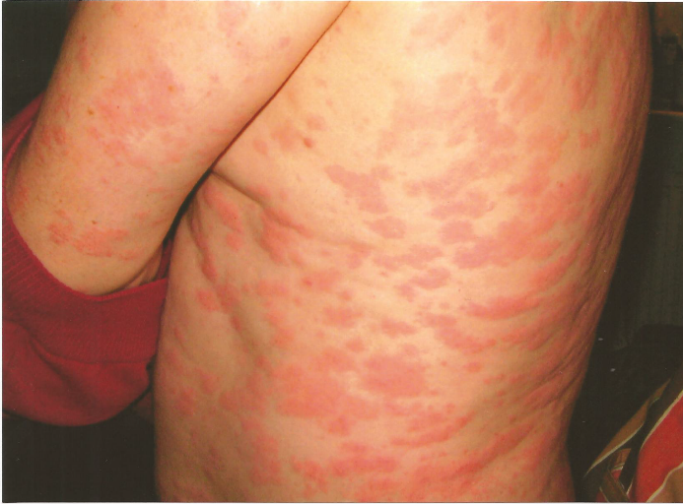
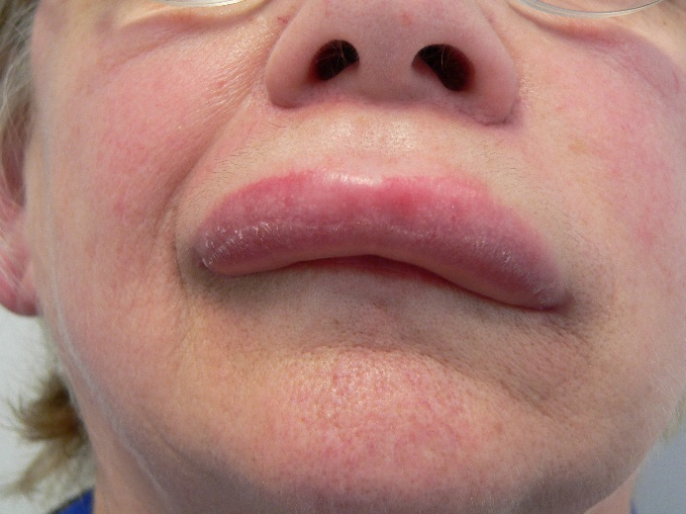
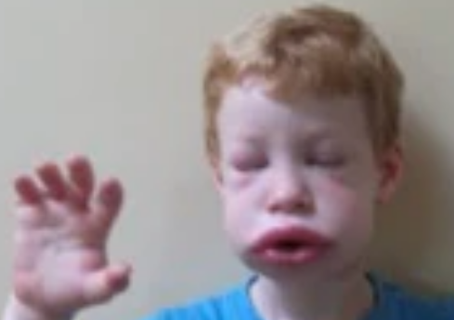
What is it if it's not chronic urticaria ?
Recurrent unexplained fever
Joint/bone pain
Malaise
Autoinflammatory
disease ?
CRP
Serum-amyloid A, S100 A8/A9, IL-1, -6
Mutation analyses
Muckle-Wells Syndrome
Average wheal duration > 24h?
Urticaria vasculitis ?
Skin biopsy
ACE inhibitor treatment?
ACE-I-induced AE ?
Stop ACE-Inhibitor
Young age
Family history
Abdominal swelling (pain attacks)
Hereditary AE ? Acquired AE ?
C1-INH conc.
C1-INH function
C4
Hereditary Angioedema

Slide 15
The 7Cs in diagnosis
Metz et al., J Allergy Clin Immunol Pract. 2021;9:2274-2283
Zuberbier et al., Allergy. 2022;77:734-766

Slide 16
Pathophysiology of urticaria
autoallergen
autoallergen-
specific
IgE
Type I - autoimmunity
(autoallergy)
Type IIb –
autoimmunity
IgG anti-FcεRI
IgG anti-IgE

Slide 17
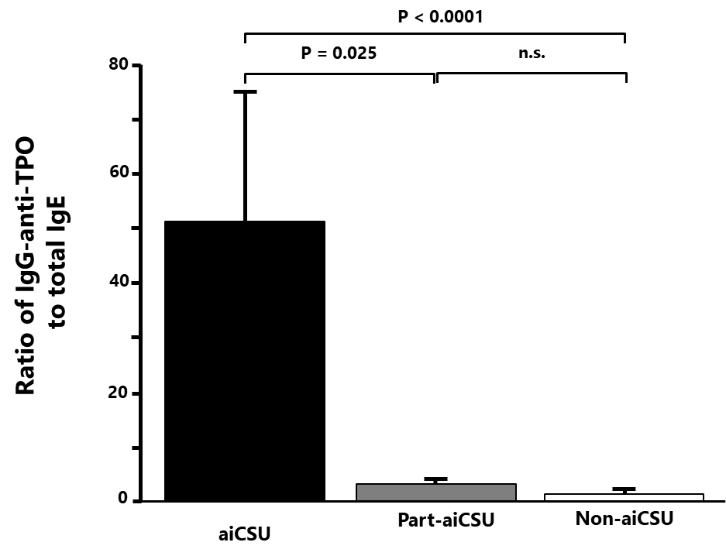
Underlying causes of CSU
Autoimmunity Type I (CSU^{aiTI}, or “autoallergic CSU”)
Autoimmunity Type IIb (CSU^{aiTIIb})
CSU due to unknown cause (CSU^{uc})
What should be done?
Total IgE
IgG anti-TPO
Basophil testing (i.e. BAT, BHRA)
Schoepke et al.,
Allergy 2019; 2427-2436
Metz et al., J Allergy Clin Immunol Pract. 2021;9:2274-2283

Slide 18
The 7Cs in diagnosis
Metz et al., J Allergy Clin Immunol Pract. 2021;9:2274-2283
Zuberbier et al., Allergy. 2022;77:734-766

Slide 19
stress foodstuff drugs infections
neuropeptides pseudoallergens complement bacteria
Working hypothesis on the pathogenesis of urticaria
Modulators
Autoimmunity
Degranulators
IgG anti-IgE
IgE
IgG anti-FcεRI
Maurer et al., Ärztl. J. Dermatol. 2018: 2; 20-22

Slide 20
Conditions that can modify disease activity
Condition to be considered
Tests that can be done if respective clues are obtained
Questions that should be asked
Food intolerance
Do you have increased disease activity in association to foods?
pseudoallergen-low diet
Drug intolerance
Do you have increased disease activity in association with NSAIDs?
Avoiding the intake of NSAIDs
Do you have increased disease activity in association with stress, anxiety, depression or sleep impairment?
Stress
HADS, referral to psychologist or psychiatrist
Do you have any chronic infection (e.g. tonsillitis, sinusitis, dental infection, urinary tract infection)?
Do you have recurrent gastrointestinal problems
ASL titer, referral to GP or respective specialist
Chronic infections
Metz et al., J Allergy Clin Immunol Pract. 2021;9:2274-2283

Slide 21
The 7Cs in diagnosis
Metz et al., J Allergy Clin Immunol Pract. 2021;9:2274-2283
Zuberbier et al., Allergy. 2022;77:734-766

Slide 22
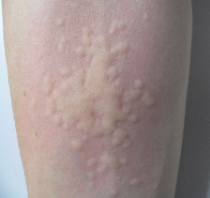
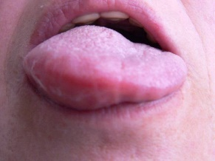
How to monitor CSU activity, impact and control
Activity
UAS
AAS
Quality of life
CU-Q₂oL
AE-QoL
Disease control
UCT
AECT

Slide 23
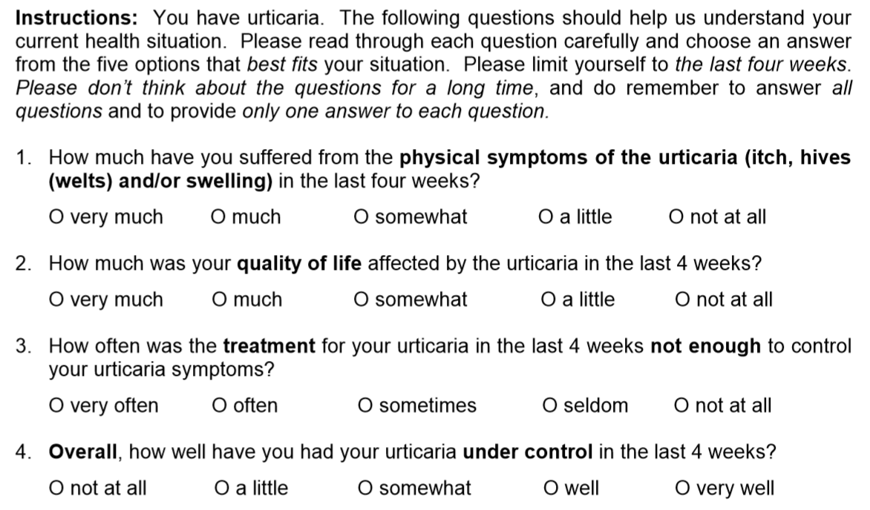

Urticaria Control Test (UCT)
well
controlled
disease
poorly
controlled
disease
Treatment sufficient?
Notes:
23

Slide 24


Urticaria Control Test (UCT)
Answer options get
0-4 points; UCT score is a sum score of the 4 questions
Maximum: 16 points
(complete control)
0P
1P
2P
3P
4P
0P
1P
2P
3P
4P
Minimum: 0 points
(no control)
0P
1P
2P
3P
4P
Cut off-value: 12 points
(≥12: well-controlled urticaria)
0P
1P
2P
3P
4P
Notes:
24

Slide 25
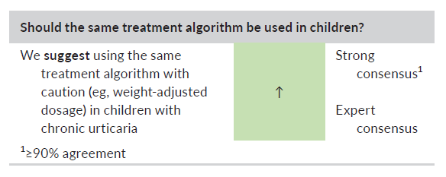
What is the aim of an optimal treatment in patients with chronic spontaneous urticaria ?
“We recommend aiming at complete symptom control in urticaria, considering as much as possible the safety and the quality of life of each individual patient.”
Zuberbier et al., Allergy. 2022;77:734-766

Slide 26
EAACI/GA²LEN/EuroGuiDerm/APAAACI
Urticaria Guideline: 2022 Revision and Update
Start with standard dose 2nd generation H1-Antihistamine
if needed:
Increase 2nd generation AH dose (up to 4x)
1
Consider referral
to specialist
Should be performed under the supervision of a specialist
Zuberbier et al., Allergy. 2022;77:734-766

Slide 27
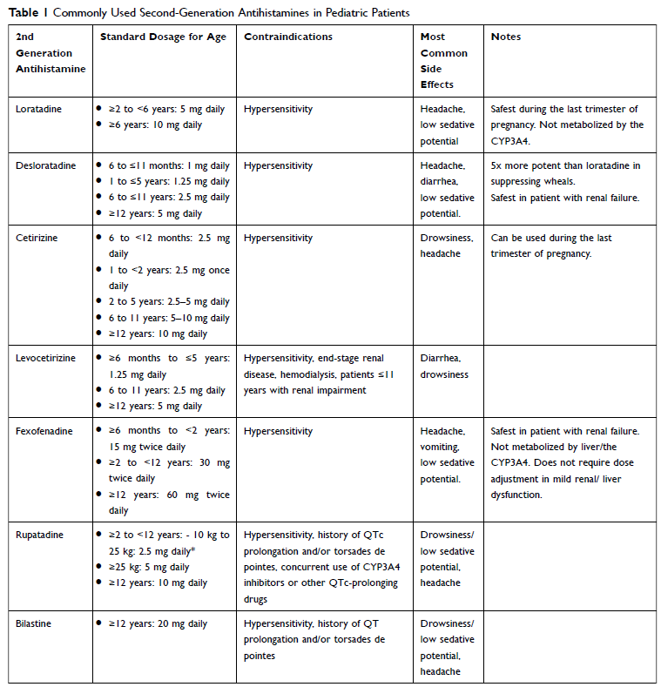
Antihistamines commonly used in children
Chang et al., J Asthma Allergy. 2021;14:187-99

Slide 28
EAACI/GA²LEN/EuroGuiDerm/APAAACI
Urticaria Guideline: 2022 Revision and Update
Start with standard dose 2nd generation H1-Antihistamine
if needed:
Increase 2nd generation AH dose (up to 4x)
1
If inadequate control on high dose: after 2-4 weeks or earlier, if symptoms are intolerable
Add on to 2nd generation AH: Omalizumab
if needed:
Increase dose or shorten intervall *
Consider referral
to specialist
2
Should be performed under the supervision of a specialist
* in CSU, Omalizumab is approved for 300mg every 4 weeks (for adults and adolescents >12 years)
Zuberbier et al., Allergy. 2022;77:734-766

Slide 29
EAACI/GA²LEN/EuroGuiDerm/APAAACI
Urticaria Guideline: 2022 Revision and Update
Start with standard dose 2nd generation H1-Antihistamine
if needed:
Increase 2nd generation AH dose (up to 4x)
1
If inadequate control on high dose: after 2-4 weeks or earlier, if symptoms are intolerable
Add on to 2nd generation AH: Omalizumab
if needed:
Increase dose or shorten intervall
Consider referral
to specialist
2
Should be performed under the supervision of a specialist
If inadequate control : within 6 months or earlier, if symptoms are intolerable
3
Add on to 2nd generation AH: ciclosporin
Zuberbier et al., Allergy. 2022;77:734-766

Slide 30
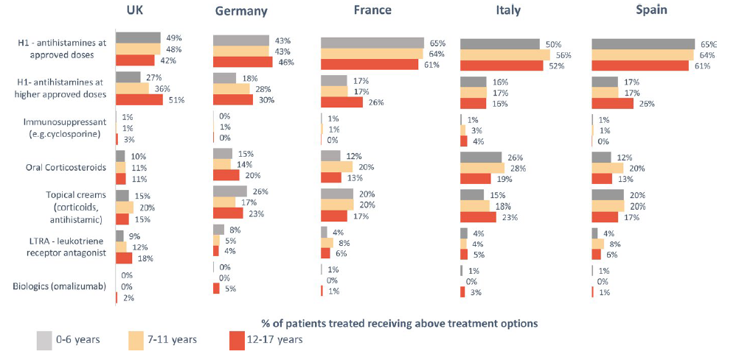
Treatment reality in children with CSU
Balp et al., Pediatr Allergy Immunol. 2018;29:630-6

Slide 31
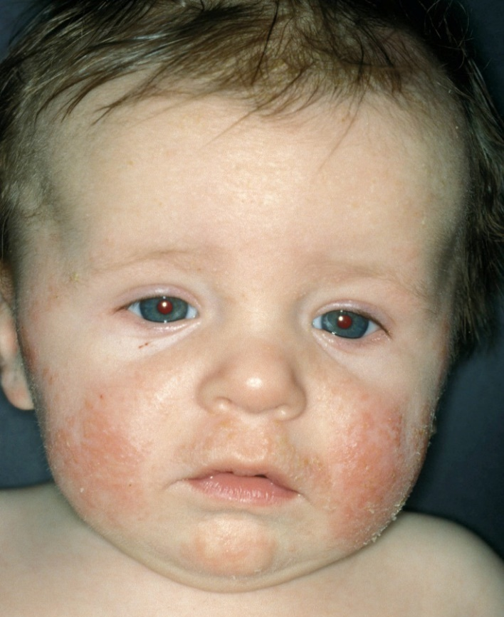
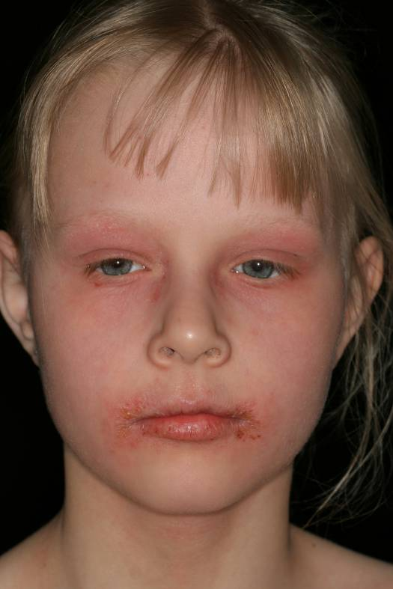
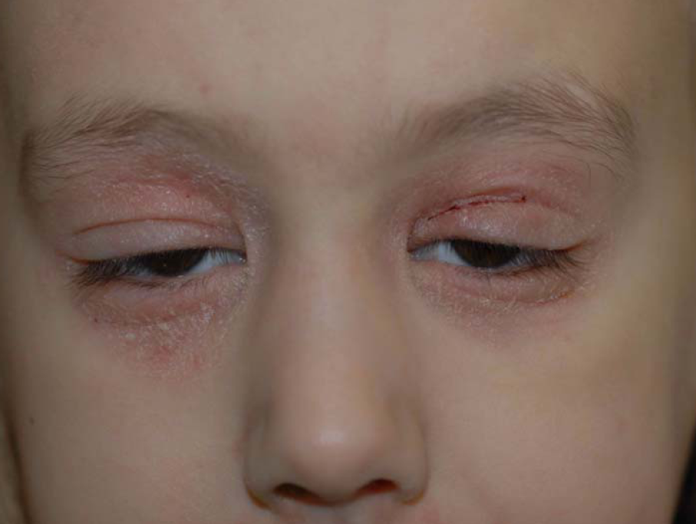
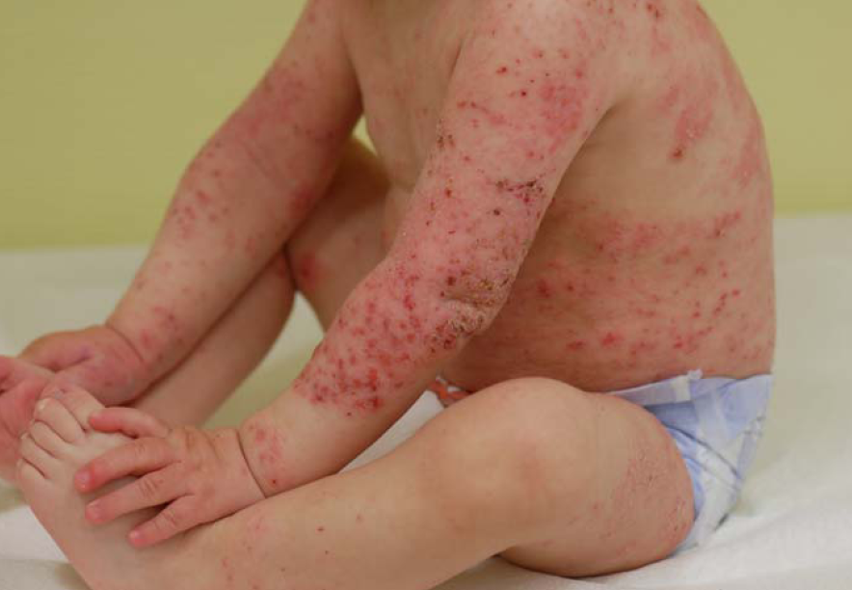
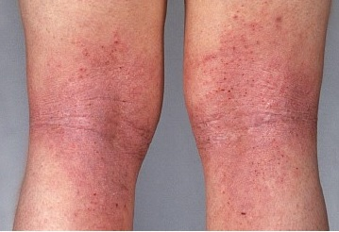

Slide 32
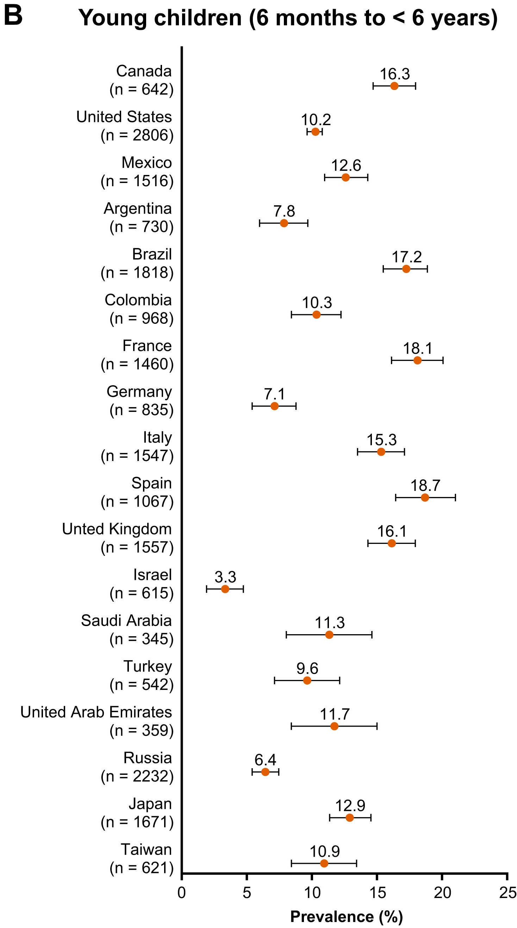
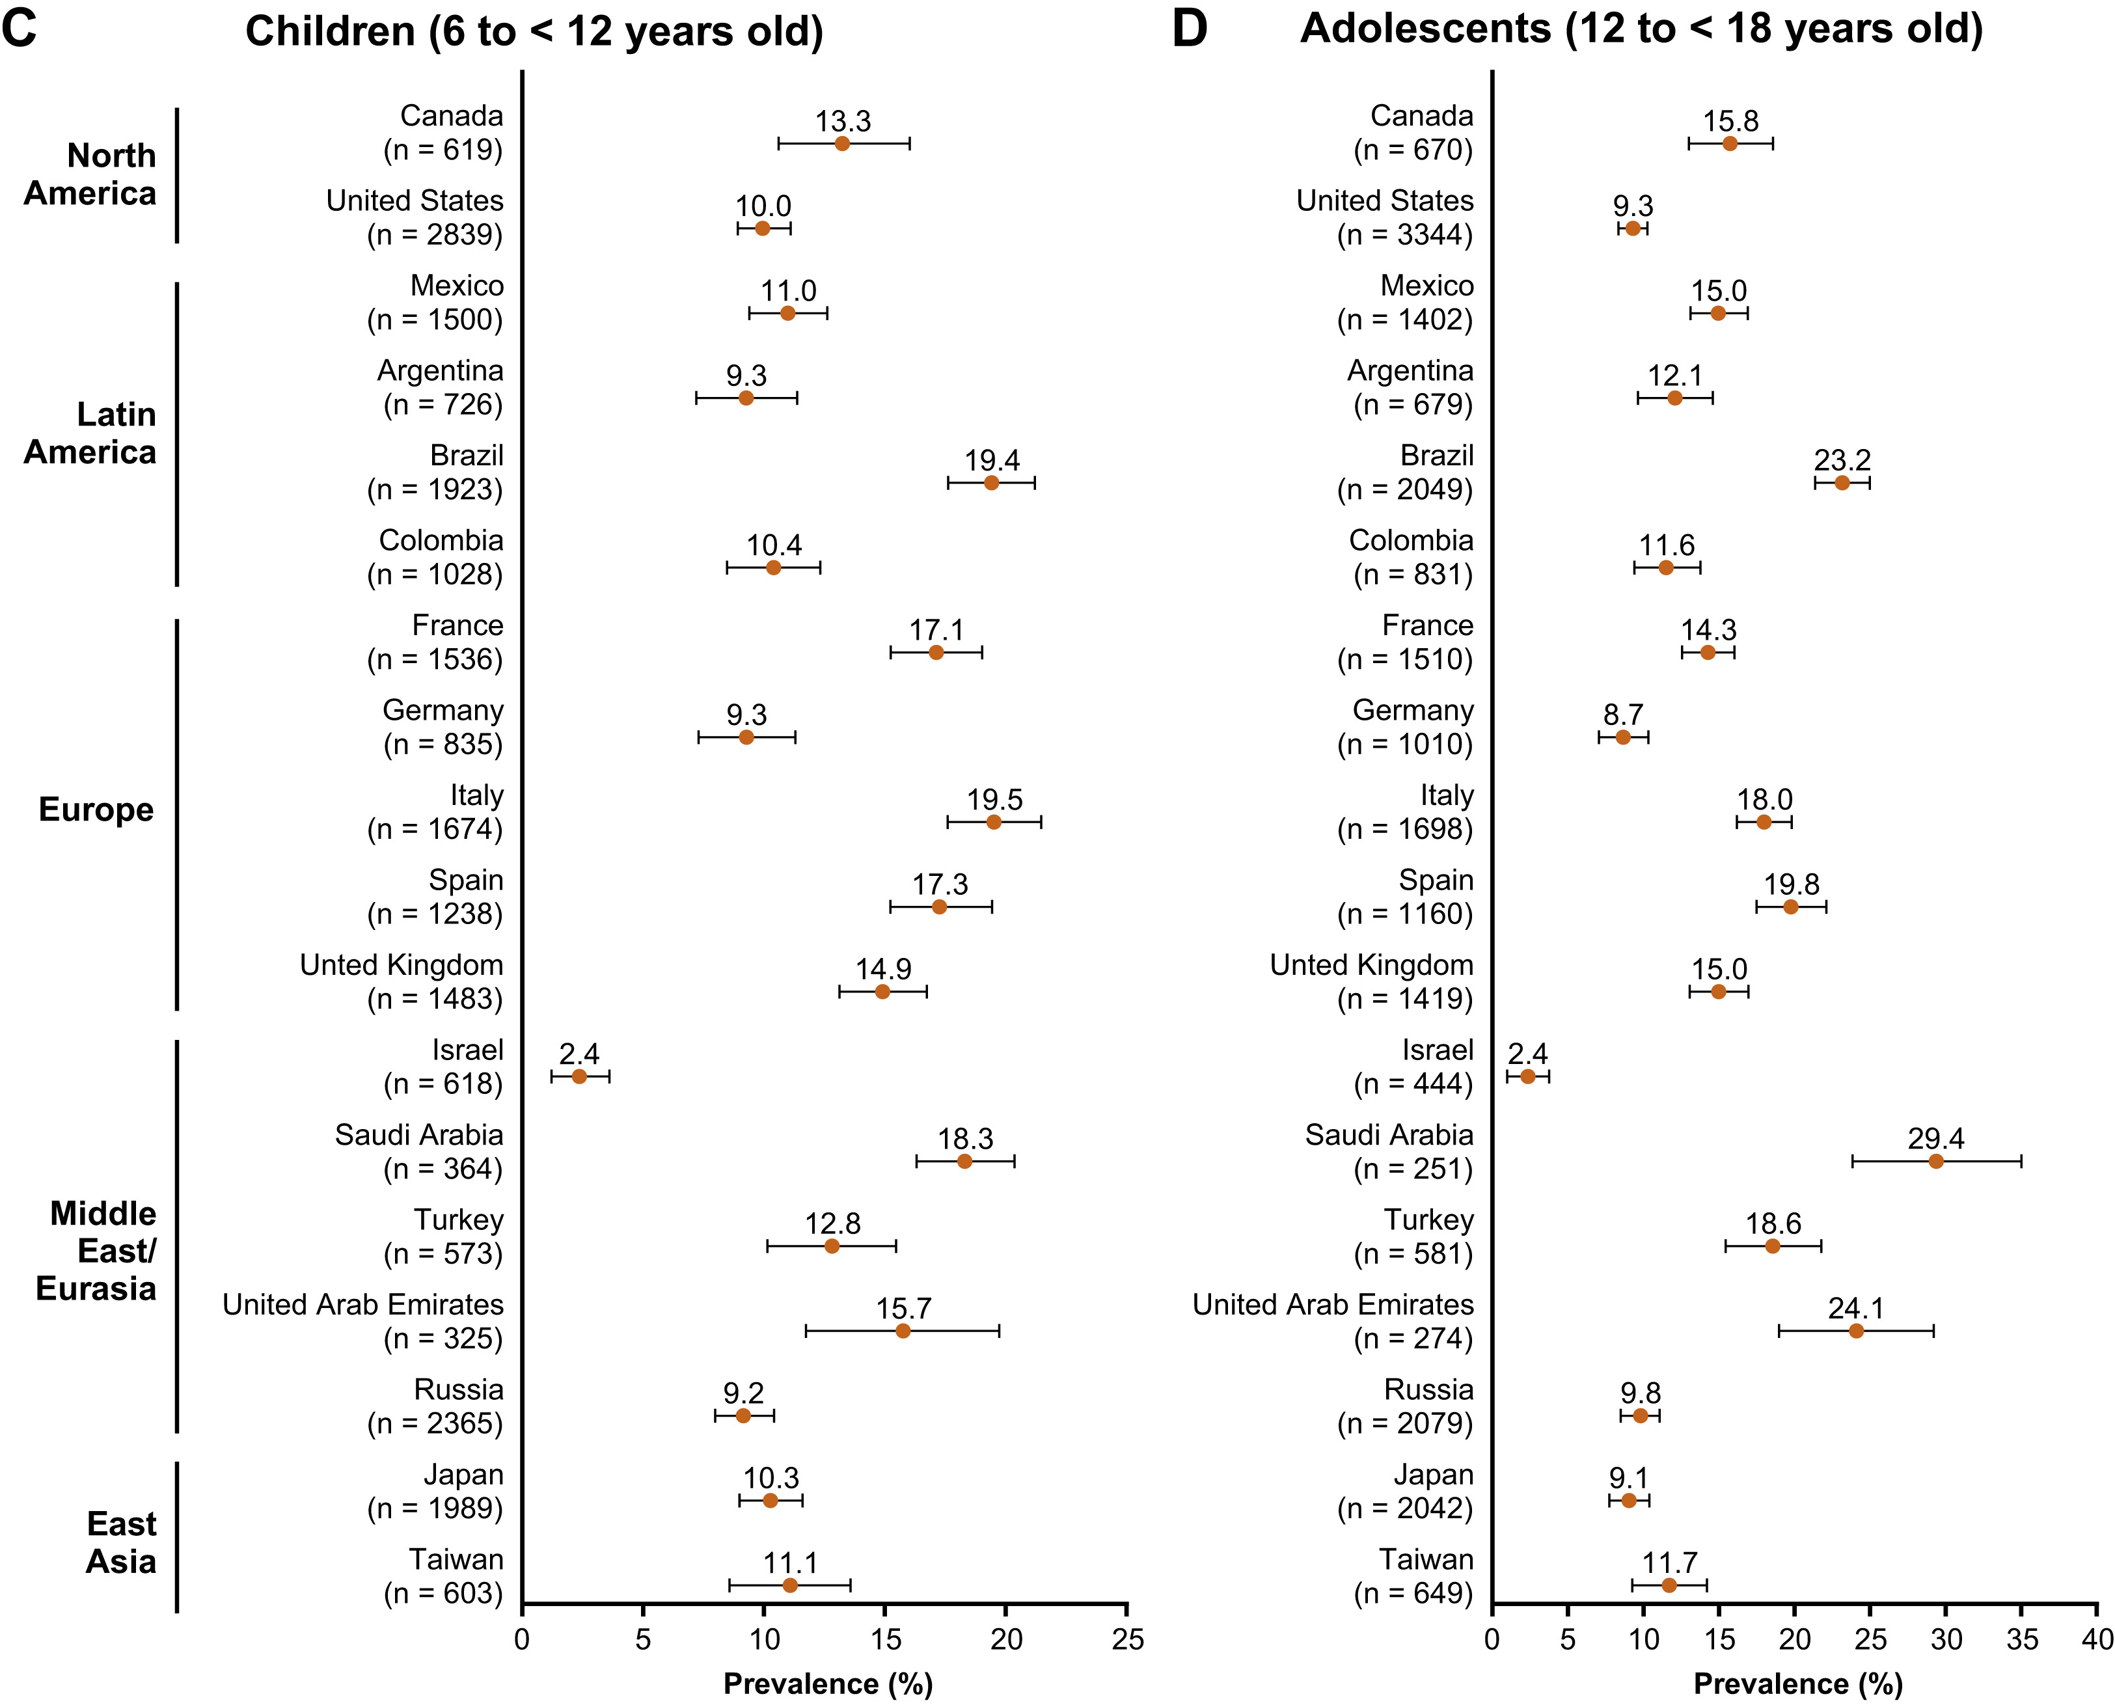
Atopic dermatitis in children and adolescents
Silverberg et al., Ann Allergy Asthma Immunol. 2021;126:417-428.e2

Slide 33
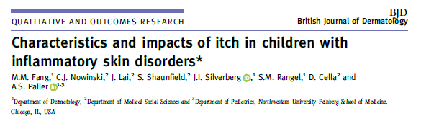
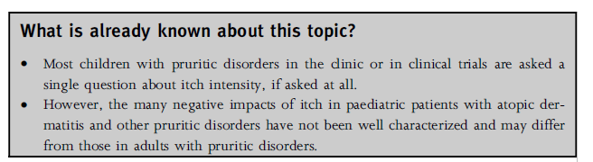
Relevance of pruritus in children with AD
Fang et al., Br J Dermatol, 2021; 184:896–904

Slide 34
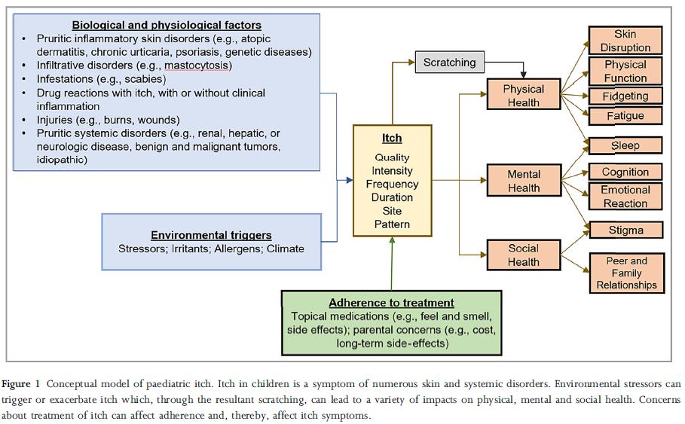
Fang et al., Br J Dermatol, 2021; 184:896–904

Slide 35

What it means to suffer from pruritus

Slide 36
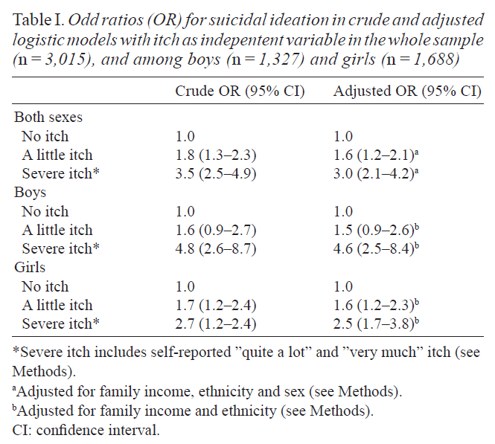
What it means to suffer from pruritus
> 3,000 students in their last school year in Oslo (2004)
Suicidal ideation
in 21.1% of all students with severe pruritus
in 8.4% of all students without pruritus
Halvorsen et al. Acta Derm Venereol. 2012 Sep;92(5):543-6

Slide 37
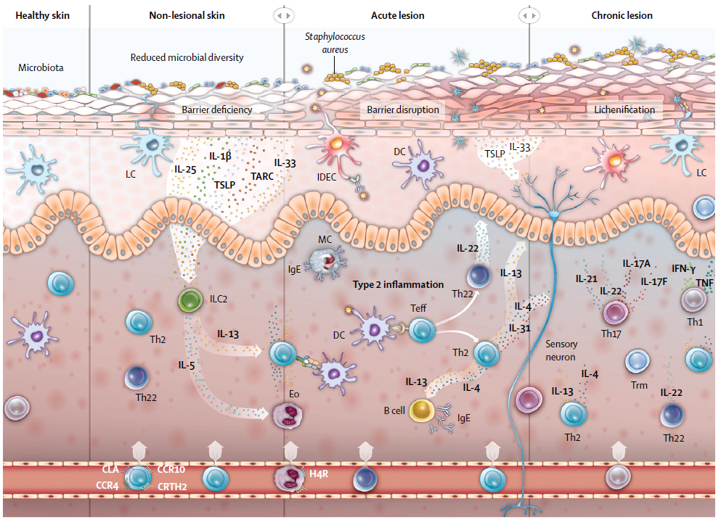
Pathomechanism of atopic dermatitis
Langan et al., Lancet 2020; 396:345-360

Slide 38

Neuroimmune interactions in AD and pruritus
Fan und Mishra, FEBS J. 2022, in press

Slide 39


Recommendations of the European guideline on the therapy of atopic dermatitis in children
Wollenberg et al, JEADV 2018;32:657–82

Slide 40
Recommendations of the European guideline on the therapy of atopic dermatitis in children
Inflammation needs to be treated !
Wollenberg et al, JEADV 2018;32:657–82

Slide 41
Recommendations of the European guideline on the therapy of atopic dermatitis in children
Dupilumab
(approved for children > 6 months)
Upadacitinib
(approved for children > 12 years)
Wollenberg et al, JEADV 2018;32:657–82

Slide 42

Efficacy of Dupilumab (anti-IL-4Rα) on Pruritus in AD in children (6-11 years)
Paller et al. J Am Acad Dermatol. 2020;83:1282-93
Notes:
42

Slide 43

www.sanofi.com, press release June 7, 2022

Slide 44

Efficacy of Upadacitinib (JAK1 Inhibitor) on Pruritus in AD in children ≥ 12 years and adults
Guttman-Yassky et al., Lancet 2021;397:2151-68

Slide 45
Summary
Chronic urticaria in children is as common as in adults
High impact on quality of life in inadequately treated children
Treat the disease until it is gone! It‘s safe and effective !
Pruritus is the biggest burden for children with AD (and their parents)
Baseline therapy (+topical steroids) is mainstay of treatment
If no adequate response, dupilumab (all children) or upadacitinib (>12y)

Slide 46


Institute of Allergology
https://ifa.charite.de
martin.metz@charite.de
https://bullahuth.de/portfolio/institut-fuer-hygiene-und-mikrobiologie

